Slide 1

EUF KO Quality
Pranav Bapat

Slide 2
What is a KO?
Metadata
+
Content (knowledge object)
+
Boilerplate (controlled vocabulary)

Slide 3
BUT
“Not all of these contribute equally to meaning or retrieval.”

Slide 4
Many KOs are extremely long or extremely short and/or noisy
Many KOs contain:
  Repeated text
  Boilerplate paragraphs
  Legal disclaimers
  Formatting leftovers
  Irrelevant content
Embedding models and search engines struggle with these.
RAG systems perform poorly when fed large, irrelevant, unfiltered context.
Outcome:
  Lower retrieval quality, higher hallucination risk, slower search, and unnecessary compute.

Slide 5
Why KO quality matters?
Knowledge Objects are only useful when:
Fairness across projects and countries and languages
Higher user trust and adoption
Search ranking stability
Better semantic retrieval
Reduced chatbot hallucinations
They can be found (searchability).
They can be understood quickly (clarity).
They are consistent with the industry standards.

Slide 6
Poor-quality KOs lead to:
Irrelevant or wrong search results
Missing or wrong filters
Weak chatbot responses
Noisy embeddings

Slide 7
The Problem

Slide 8
Some examples
67d1a83dd2f3ec5aa09a5aba
68b553b100f60afb29427754
686e1fd5497da684268d9dda
68b55330017b8b75556d9ef1
68773f88e4df4f63e71d9007
6716ac6f209cd9bd370e5972
66b1f00e45168fd6c4c56ea8
686f6d6cdaff72a695636f22
These issues are not rare edge cases; they are common patterns.

Slide 9
What Do We Mean by “KO Quality”?
How complete, clear, consistent, accurate, and usable a Knowledge Object is
Both as a standalone and as an input into search, indexing, and reasoning systems.
Quality = Structural + Semantic + Domain + Functional (ISO 25012 Data Quality)
Structural = length + completeness + noise + formatting
Semantic = clarity + usefulness + information density + consistency
Domain = correct agricultural terminology and context
Functional = works well for BM25, embeddings, neural/semantic search, RAG (chatbot)

Slide 10
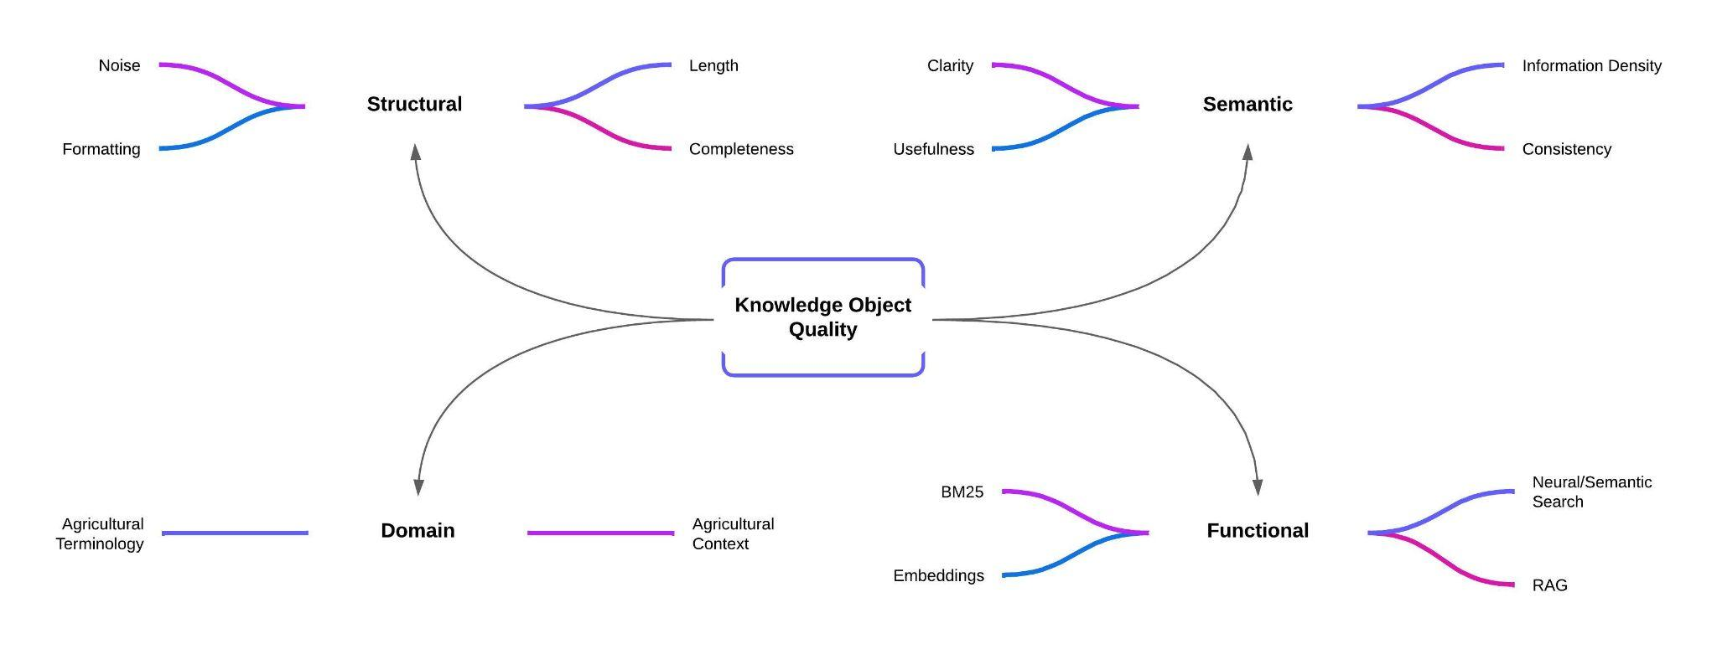
What Do We Mean by “KO Quality”?

Slide 11
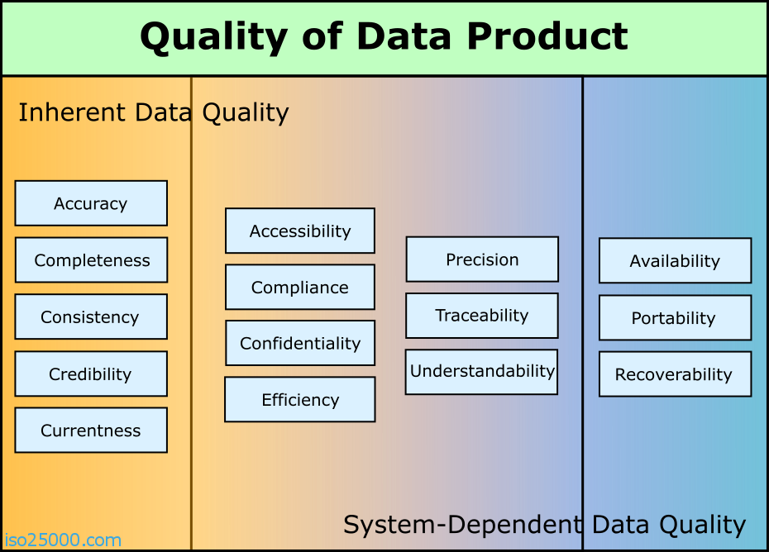

Slide 12
Sample Knowledge Object
"@id": "https://ugent-dict-farmbook-prd.s3.ugent.be/knowledge-object-prd/7c9e43d16b50ec66ab4d503584e23456",
"title": "Women Innovators in Ireland - Rural Fact Sheet #038",
"subtitle": "",
"description": "Fiona founded ‘Count on Us Recruitment’ to help family carers in Ireland find flexible part-time jobs (up to 18.5 hours/week) that fit their caregiving needs. Her service connects carers with employers seeking skilled, flexible workers, addressing a gap in the labor market. Fiona was named All-Star Social Entrepreneur of 2022. The initiative supports carers’ wellbeing and helps businesses fill labor shortages.",
"keywords": ["social innovation", "gender equality"],
"creators": ["Maura Farrell, Aisling Murtagh, Louise Weir"],
"languages": ["English"],
"date_of_completion": "2024-07-26",
"intended_purposes": ["Dissemination"],
"locations": [{"name": "Ireland","nuts_id": "IE"}, {"name": "Ireland", "nuts_id": "IE0"}],
"category": "Document",
"topics": ["Society"],
"themes": ["Social innovation"],
"license": "CC BY-SA",
"project_id": "0ebe9ca0be9ebadaf3790db6970305d74a90dba971ec3396f77ec50e672f509c",
"ko_created_at": "2025-09-08T20:39:56.169000",
"ko_updated_at": "2025-09-08T20:39:56.169000",
"project_display_name": "FLIARA",
"project_type": "Horizon Europe",
"locations_flat": ["Ireland"],
"subcategories": ["Factsheet"],
"project_name": "FLIARA: Female-Led Innovation in Agriculture and Rural Areas",
"project_acronym": "FLIARA",
"project_url": "https://fliara.eu/",
"project_doi": "10.3030/101084234",
"proj_created_at": "2024-12-03T13:43:58.802000",
"proj_updated_at": "2025-08-01T09:33:41.800000",
"_orig_id": "68650ce67807d9bc7a0b3d82",
"ko_content_flat": "Rural Fact Sheet # Count On Us Recruitment THE INNOVATION JOURNEY Fiona established 'Count on Us Recruitment' to offer a unique service to family …… ……. USEFUL LINKS https: //countonusrecruitment.ie/"

Slide 13
Auditing KO
(What, Why, How)

Slide 14
What we analysed
Full KO export: 7,116 KOs (24-11-2025).
Each KO contains 19 metadata and content fields
Fields fall into two broad groups:
  Knowledge-carrying (textual) fields
    title, subtitle, description, keywords, ko_content_flat
  Boilerplate / facet fields
    topics, themes, languages, locations_flat, category, subcategories, licence, project_type, date_of_completion, creators, project_acronym, project_display_name, project_name
Not all fields are designed to carry semantic meaning or support retrieval.

Slide 15
Evidence-Based Field Selection

Slide 16
Why We Need Evidence-Based Field Selection
Not all metadata fields contribute equally to retrieval.
Some fields are highly discriminative (e.g., title, description, etc.)
Others are boilerplate or controlled vocabulary (e.g., topics, themes, category, etc.).
We needed to separate semantically useful fields (for search, embeddings, RAG) from boilerplate fields (for facets, filtering, admin only).
We wanted this to be data-driven, not based on intuition or schema design.
Without evidence-based analysis, we risk:
  skewed search ranking
  poor semantic retrieval
  unnecessary embedding of repetitive fields
  inconsistent chatbot responses

Slide 17
How We Identified Which Fields Matter
We applied three analytical layers:
Corpus Diagnostics
  How much text exists, how often it appears, and how repetitive it is.
Self-Retrieval Testing (MRR@10)
  Whether a KO can be found using its own content in a search setting.
Field Usefulness Score (FUS)
  A combined signal to compare fields consistently.
These analyses are used to identify which fields meaningfully contribute to quality, not to optimise content yet.

Slide 18
How Fields Were Evaluated
Each field was examined along four intuitive questions:
Coverage - Is the field consistently populated across KOs?
Textual richness - Does it contain enough meaningful language to carry information?
Redundancy - Is the same value repeated across many KOs (boilerplate)?
Discriminative power - Does the field help distinguish one KO from another in search?
Together, these signals indicate whether a field is suitable for:
semantic quality,
retrieval,
and downstream reasoning.

Slide 19
How we evaluated each field
Corpus diagnostics (per field)
For each field we computed:
    Coverage - in how many KOs is this field populated?
    Average length (tokens) - how much text does it carry?
    Boilerplate ratio - how often is the exact same value repeated?
      boilerplate = 1 - (#unique values / #KOs)
    Average IDF (BM25) - how discriminative the terms are within that field.
Self-retrieval test (BM25, MRR@10)
For each KO, we:
    used its title (Q1) and title+keywords (Q2) as the query;
    tested different index configurations (single fields and combinations).
Metric: Mean Reciprocal Rank @10 (MRR@10)
    1.0 = always ranked 1st
    0.1 = usually at rank 10
    ≈ 0 = almost never in the top 10.

Slide 20
Field Usefulness (Which fields actually carry retrieval signal?)
 | Fields | Useful for
High-signal fields | Title Description Keywords KO content | contain unique language, vary meaningfully across KOs, and support search and semantic retrieval.
Low-signal fields | Controlled vocabularies and administrative metadata (e.g. topics, licence, project type, language) | Filtering, Faceting, Governance but not for semantic quality or ranking.

Slide 21
What the Field Audit Showed

Slide 22
Rich, unique text fields (highly discriminative, useful for ranking/embeddings)
Field | Coverage | Avg Tokens | Avg IDF | Boilerplate
title | 1.00 | 10.8 | 7.94 | 0.02
description | 1.00 | 65.7 | 7.80 | 0.03
keywords | 1.00 | 10.7 | 7.90 | 0.06
ko_content_flat | 1.00 | ~2388.1 | 7.94 | 0.12

Slide 23
Short, highly repeated vocabularies (controlled vocabularies, facet-only)
Field | Coverage | Avg Tokens | Avg IDF | Boilerplate
date_of_completion | 1.00 | 3.0 | 4.22 | 0.81
project_type | 1.00 | 2.7 | 2.56 | 1.00
licence | 1.00 | 2.6 | 1.64 | 1.00
topics | 1.00 | 2.5 | 1.08 | 0.95
locations | 0.98 | 1.2 | 5.67 | 0.97
category | 1.00 | 1.0 | 4.65 | 1.00
languages | 1.00 | 1.2 | 4.48 | 0.96
subcategories | 1.00 | 2.1 | 5.41 | 0.95
project_acronym | 1.00 | 4.4 | 7.74 | 0.78
project_name | 1.00 | 11.4 | 7.53 | 0.78

Slide 24
Self-retrieval: which fields actually find their own KO?
Key MRR@10 (Q1 = title as query):
title alone: MRR@10 = 0.9881 (almost perfect self-retrieval).
ko_content_flat: 0.7058 (strong, despite noise).
description: 0.5479 (helps, but less focused).
keywords: 0.4247 alone, but combined with title:
  keywords + title: 0.9824 (Q1) and 0.9979 (Q2).
Boilerplate / controlled fields on their own:
topics: 0.0004
themes: 0.0030
category, project_type, licence: ≈0.0004-0.0006
languages, locations_flat, subcategories: ≈0.001-0.003

Slide 25
Field Usefulness Score
To compare fields consistently, we use a Field Usefulness Score that combines:
retrieval behaviour,
textual discriminativeness,
field coverage,
and redundancy penalties.
Higher usefulness score = stronger candidate
for quality assessment, ranking, and embeddings.

Slide 26
How we evaluated each field
Field Usefulness Score (FUS)
  For single fields, we combined all signals into one score:
    70%: normalised MRR@10 (self-retrieval power)
    15%: normalised average IDF (discriminative terms)
    10%: normalised coverage (how widely used)
    -5%: boilerplate penalty (repetitiveness across KOs)
    Higher FUS = better candidate for ranking / embeddings.

Slide 27
The Goal

Slide 28
Produce clean, information-dense summaries that preserve meaning
We want to convert:
Long Version (L-text): Raw and/or unclean and/or unfocused content
Short Version (S-text): Concise, coherent, meaning-preserving summaries.

Slide 29
Produce clean, information-dense summaries that preserve meaning
The hypothesis
Shorter, denser text improves:
  Embedding quality
  Search engine indexing
  Search results ranking
  Neural/semantic retrieval
  Chatbot grounding in RAG

Slide 30
Ideal Length Ranges
title - 6-14 words, 45-90 chars
subtitle - 8-20 words, 140 chars
description - 40-80 words, 300-600 chars, 2-4 sentences
ko_content_flat - >600 chars, structured paragraphs
keywords - 4-10 meaningful terms

Slide 31
Ideal Length Ranges
https://developers.google.com/search/docs/appearance/title-link
https://developers.google.com/search/docs/fundamentals/creating-helpful-content
  Titles should be concise, descriptive
  Avoid keyword stuffing
  Use clear, human-readable phrasing
  Meta descriptions (subtitles) should summarise the content effectively (around 0-160 chars)
https://www.dublincore.org/specifications/dublin-core/dces/
  Titles must be concise, unambiguous
  Descriptions should be meaningful summaries
  Subjects (keywords) should use controlled terms when possible
  Metadata should be “fit for discovery and retrieval”

Slide 32
Ideal Length Ranges
https://iso25000.com/index.php/en/iso-25000-standards/iso-25012
  Supports rules (STRUCTURAL → SEMANTIC → PRAGMATIC):
    Accuracy
    Completeness
    Consistency
    Conciseness
    Accessibility
    Understandability
https://www.w3.org/TR/dwbp/
  Clean, consistent fields
  Avoiding ambiguous language
  Clarity and interoperability
  Using meaningful keywords/tags
https://nlp.stanford.edu/IR-book/
  Optimal keyword length
  Avoiding generic/stopword-heavy text
  Title terms carry strongest weight in ranking
  Description improves recall
  Longer content improves embedding quality

Slide 33
Diagnostics: “rich text” vs “boilerplate vocabularies”
Rich, unique text fields
title - coverage 1.00, avg_tokens 10.8, avg_idf 7.94, boilerplate 0.02
description - coverage 1.00, avg_tokens 65.7, avg_idf 7.80, boilerplate 0.03
keywords - coverage 1.00, avg_tokens 10.7, avg_idf 7.90, boilerplate 0.06
ko_content_flat - coverage 1.00, avg_tokens ~2388, avg_idf 7.94, boilerplate 0.12
Short, highly repeated vocabularies
category - coverage 1.00, avg_tokens 1.0, boilerplate 1.00
project_type - coverage 1.00, boilerplate 1.00
licence - coverage 1.00, boilerplate 1.00
topics - coverage 1.00, avg_tokens 2.5, avg_idf 1.08, boilerplate 0.95
languages - coverage 1.00, boilerplate 0.96
subcategories, project_acronym, project_name, project_display_name, date_of_completion, locations_flat - all with very high boilerplate (0.78-0.97).

Slide 34
Summary
We analysed 7,116 KOs using objective metrics.
We identified the 5 fields that materially affect retrieval.
We assigned KO-quality weights based on evidence, not assumption.
If we improve this, it will improve:
  search ranking
  semantic retrieval
  RAG quality
  overall KO usability for stakeholders.

Slide 35
Thank you

Slide 36
How This Informs KO-Quality Scoring
We now align KO-quality weights to match the empirical evidence:
Semantic Precision (40 points)
  Why high weight?
    Strongly dependent on fields with highest FUS (title/description/keywords).
Content Richness (20 points)
  Why separate bucket?
    ko_content_flat has high FUS but is long/noisy → deserves distinct evaluation.
Cross-Field Consistency (20 points)
  Why lower weight?
    topics/themes/category have low FUS, so used for consistency, not scoring.
Linguistic Integrity (20 points)
  Improves readability, search performance and RAG faithfulness.

